Slide 1

Modern Database Systems: NewSQL, NoSQL and Modernized Classic Systems
NetApp 7th Annual University Day
NetApp HQ, Sunnyvale, CA, USA
17 February 2014
C. Mohan
IBM Fellow and Former IBM India Chief Scientist
IBM Almaden Research Center, San Jose, CA 95120, USA
cmohan@us.ibm.com http://bit.ly/CMohan
Talk Version of Tutorial Presented First at
39th International Conference on Very Large Data Bases (VLDB)
Riva del Garda, Italy, 29 August 2013
Links to Revised Tutorial Slides and Bibliography at http://bit.ly/CMnMDS

Slide 2
Background + Warnings
My personal opinions, NOT necessarily IBM’s positions/opinions
Lots of hype on NoSQL (lesser on NewSQL) in industry, academia & VC world – this Kool-Aid has intoxicated many ☺
Been a details oriented, hard core DB person for > 3 decades –
I go beyond hype, am not easily swayed by the latest fashion!
Not a relational bigot – most of my results on systems topics have applied to all sorts of persistent, distributed information systems
Have dissected many IBM and non-IBM systems’ internals (including pre- and post-relational ones)
Don’t claim to have all the answers or make definitive assertions
Aim: not exhaustive survey of modern systems or details of too many specific systems – broad brush analysis of good (sensible) and bad (nonsenSQL) of NoSQL/NewSQL, warn of pitfalls –
time to pause and introspect. Give a few systems’ interesting details.
NOT against NoSQL but unhappy with choices on internals, design justifications (“anything goes”), and not learning enough from the past

Slide 3
Some Quotes
Jack Clark, The Register, 30 August 2013: “The tech world is turning back toward SQL, bringing to a close a possibly misspent half-decade in which startups courted developers with promises of infinite scalability and the finest imitation-Google tools available, and companies found themselves exposed to unstable data and poor guarantees.”
Google Spanner paper, October 2012: “We believe it is better to have application programmers deal with performance problems due to overuse of transactions as bottlenecks arise, rather than always coding around the lack of transactions.”
Sean Doherty in Wired, September 2013: “But don’t become unnecessarily distracted by the shiny, new-fangled, NoSQL red buttons just yet. … Relational databases may not be hot or sexy but for your important data there is no substitute.”
Gartner estimates RDBMS market at $26B with about 9% annual growth
Market Research Media Ltd expects NoSQL market to be at $3.5B by 2018

Slide 4
Introduction
Goal: Broad Survey of Modern Database Systems (MDS)
Drivers Behind Emergence of MDS, Benchmarks/Performance Studies
Classes of MDS
  Evolution of Classical DBMSs (DB2, SQL Server, Oracle, Informix, PostgreSQL)
  Brand New Systems (NewSQL, NoSQL)
  Hybrid Systems (Hadoop + SQL)
Overviews of Specific Systems
  DB2 BLU, IDAA, MS Hekaton, Oracle Exadata, Informix Warehouse Accelerator, Postgres Plus Advanced Server
  SAP Hana, Google F1, NuoDB, VoltDB, HyPer, Calvin
  MongoDB, DB2/Informix NoSQL, Oracle NoSQL, Aerospike, Neo4j, Facebook Tao
Deployments or Use Case Scenarios: Facebook
Ack: Figures and tables sourced from documentation/papers/web pages!
Links to Slides and Bibliography at http://bit.ly/CMnMDS

Slide 5
Drivers of MDS Features
Hardware Trends: Multicore, Multi-socket, InfiniBand, DRAMs, SSDs, FPGAs, GPUs, Storage Class Memories (e.g., PCM)
Big Data (esp. Semi Structured or Unstructured): Compression, Column Handling, Scalability (Sharding), Avoiding Data Loading, Linkage to Analytics Tools, …
Wider Adoption of Database Technology: Ease of Use, Appliances
Monetary Constraints: Open Source, Commodity Processors/Disks, Local Disks, Economic Factors in General
Skills Shortage: DBAs, Admins in General, SQL Knowledge, …
Social Media: Relationship Graphs, Ultra Low Response Times, Data Heterogeneity/Volume, Mobile Users
Internet of Things (IOT): Smarter Planet, Sensors, Low Power, …
Cloud Platforms: Elasticity, Multi-tenancy, Security, Transborder Data Flows

Slide 6
Hardware Trends
DRAM costs 17X SSD! Dell $20/GB DRAM (16 GB DIMM $315)
SSD 10X HDD cost ($0.10/GB, 200 IOPS)
SSD: Samsung 840, 250 GB, $180
4 drives/chassis: 1 TB, 384K read IOPS, 248K random write IOPS, $720, 0.3 Watts
DBs under 100 GB: DRAM
100 GB – 2 TB: SSD
>1 PB: HDD
Open source Aerospike Certification Tool for SSDs for real-time use cases

Slide 7
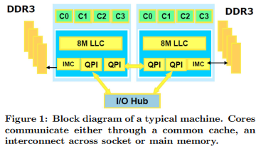
Conclusions from Workload Studies
EPFL Studies
  OLTP workloads in traditional DSs don’t leverage aggressive micro-architectural features, wasting time in memory stalls, resulting in low instructions per cycle (IPC)
  L1 instruction misses cause significant stall times with index probes dominating instruction & data stalls
H-Store: significant time spent in lock/latch, buffer pool fixes/unfixes
Sort Vs Hash join & NUMA effects revisited in multicore/multi-socket systems
QPI – QuickPath Interconnect
IMC – Integrated Memory Controller

Slide 8
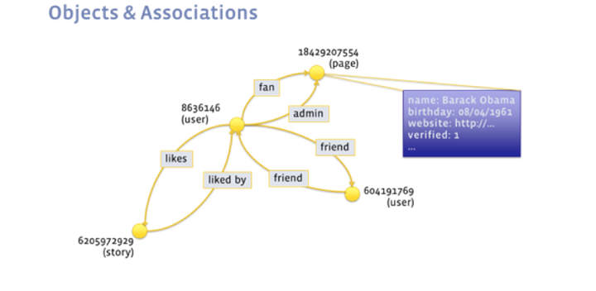
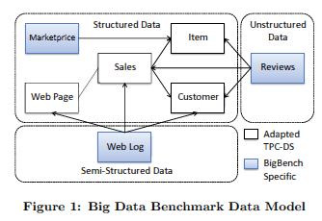
Benchmarks
TPC benchmarks (e.g., TPC-C, TPC-E, TPC-H)
LinkBench: Facebook’s Benchmark Based on Social Graph
BigBench: Benchmark for Big Data Analytics
  Teradata, University of Toronto, InfoSizing , Oracle
  Product Retailer Scenario
  Addresses Variety, Velocity & Volume of Big Data
  Structured (TPC-DS), Semistructured (user clicks), Unstructured (product reviews)
  Queries Cover Analytics Proposed by McKinsey: Marketing (Cross Selling, Customer Micro-Segementation, Sentiment Analysis, Enhancing Multichannel Consumer Experience), Merchandising (Assortment Optimization, Pricing Optimization), Operations (Performance Transparency, Return Analysis), Supply Chain (Inventory Management), New Business Models (Price Comparison)
  Feasibility Illustrated via Teradata Aster Database’s SQL-MR

Slide 9
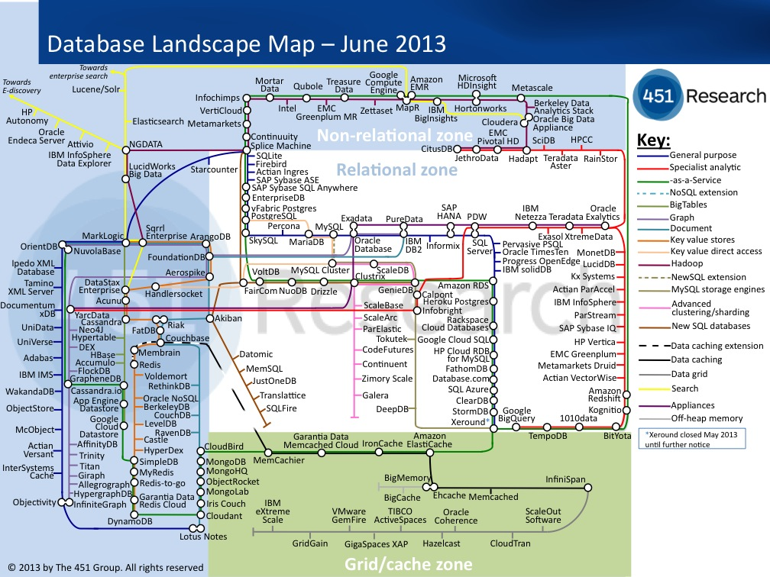
https://blogs.the451group.com/information_management/files/2013/06/451db_map_06.13.jpg

Slide 10
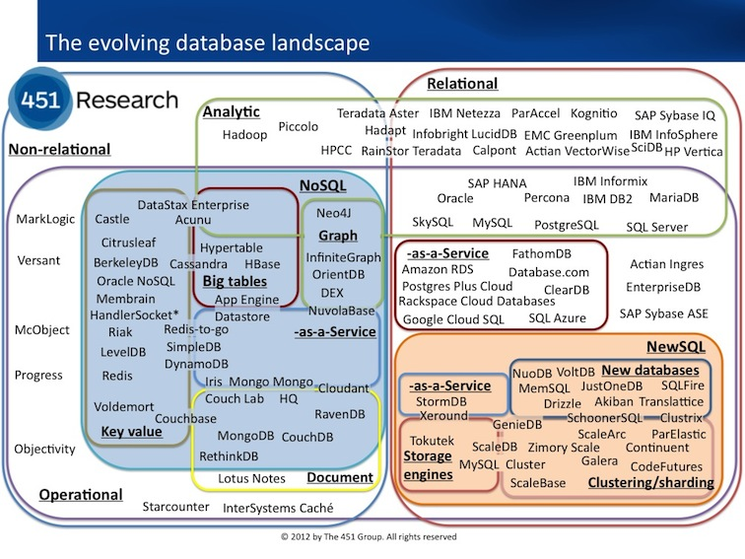
Database Product Landscape – Matthew Aslett 11-2012
http://blogs.the451group.com/information_management/files/2012/11/DBlandscape.jpg

Slide 11
Evolution of Classical DBMSs

Slide 12

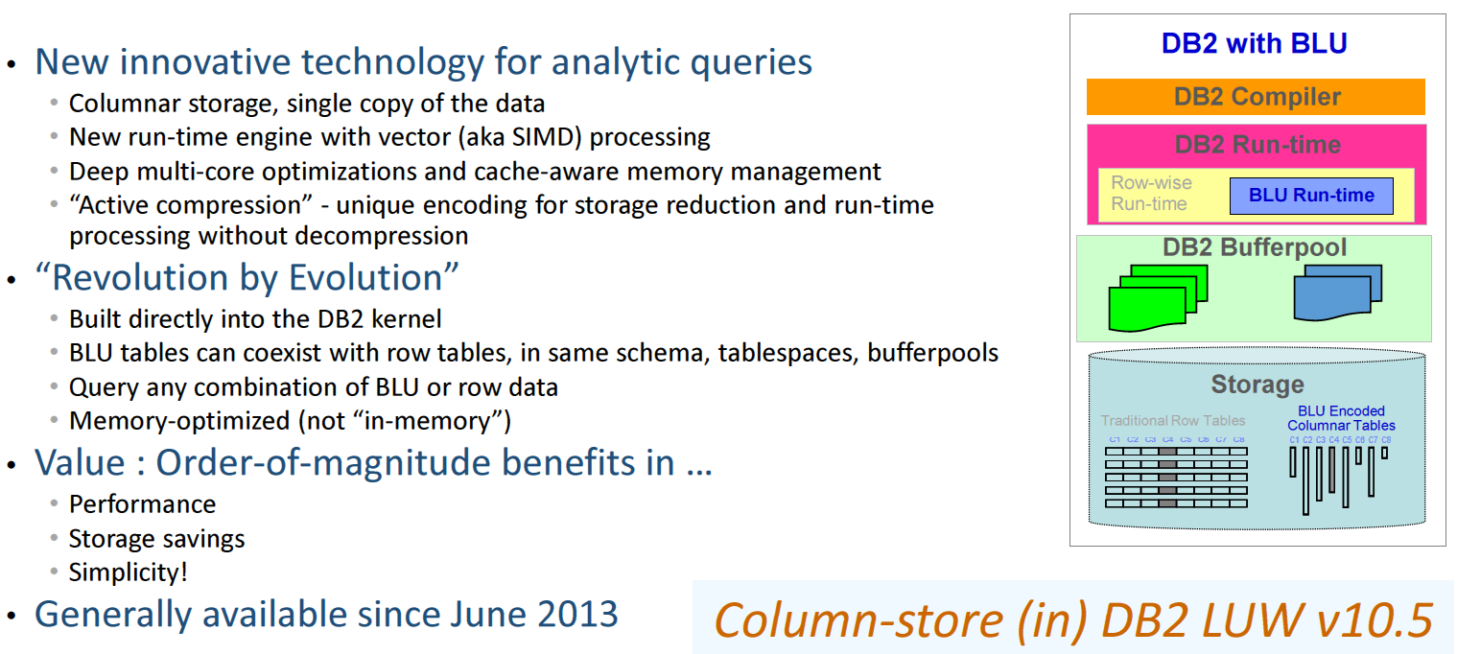
DB2 with BLU Acceleration
V. Raman et al. DB2 with BLU Acceleration: So Much More than Just a Column Store.
Proc. VLDB Endowment (PVLDB), 2013.

Slide 13
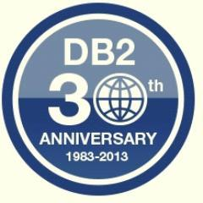

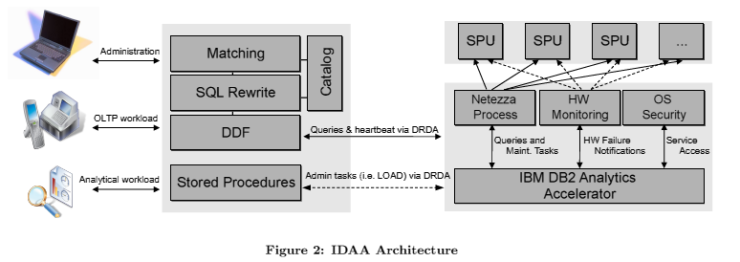
IBM DB2 Analytics Accelerator (IDAA)
Data from DB2 z replicated continuously to Netezza
Offload complex queries from DB2 z to Netezza for more efficient/cheaper execution
Queries execute with snapshot semantics since Netezza supports MVCC
Replaced IBM Smart Analytics Optimizer (ISAO) where Blink technology was used
Evolution of Blink is what is now in DB2 BLU
Martin, D., Koeth, O., Ivanova, I., Kern, J. Near Real-Time Analytics with IBM DB2 Analytics Accelerator,
Proc. International Conference on Extending Database Technology (EDBT), Genoa, Italy, March 2013.

Slide 14
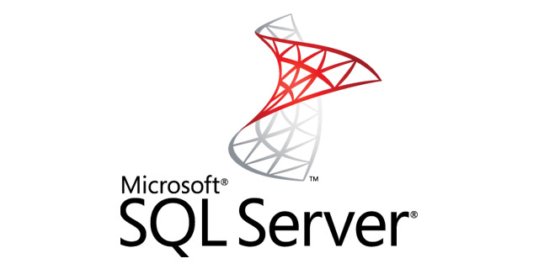
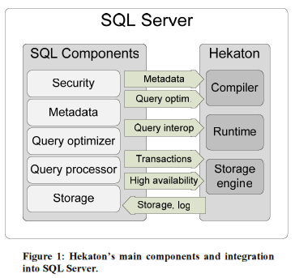
Hekaton: SQL Server’s In-Memory
OLTP Engine
Alternate data manager integrated with SQL Server
All Hekaton data in memory with lock/latch-free optimistic, multiversion concurrency control
Declare table to be memory optimized
T-SQL stored procs accessing only Hekaton tables compiled into machine code
Hash and range indexes
Optionally non-durable tables
Index updates not logged; rebuilt during recovery from checkpoint and logs.
C. Diaconu, C. Freedman, E. Ismert, P. Larson, P. Mittal, R. Stonecipher, N. Verma, M. Zwilling: Hekaton: SQL Server's Memory-Optimized OLTP Engine. Proc. ACM SIGMOD International Conference on Management of Data, New York, USA, June 2013.

Slide 15
NewSQL Systems

Slide 16
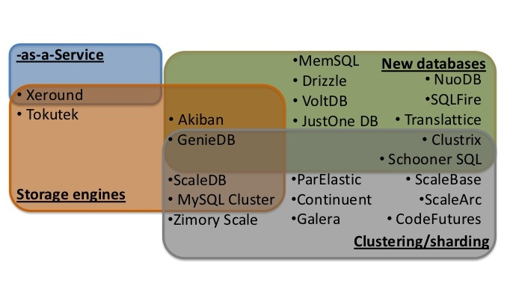
NewSQL Ecosystem - Matthew Aslett 2012

Slide 17

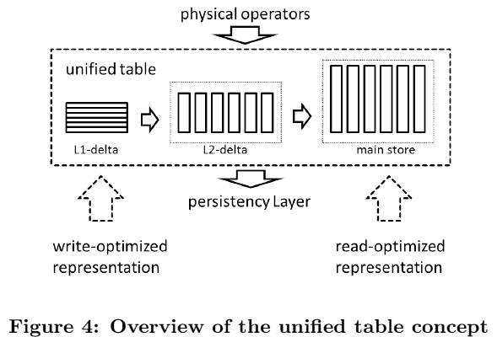
SAP Hana (OLTP+OLAP)
L2 delta dictionary encoded, no compression for L1
Main store maximally compressed with many schemes

Slide 18
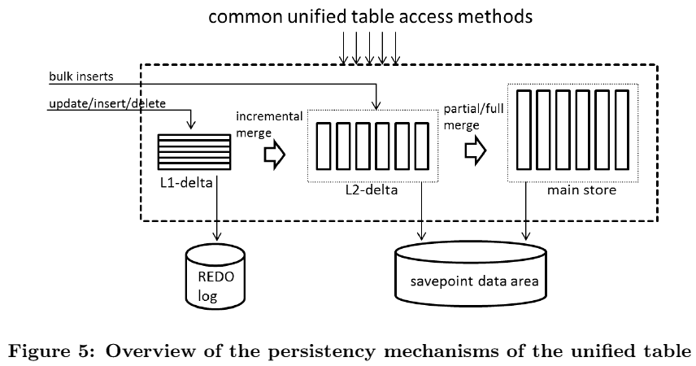
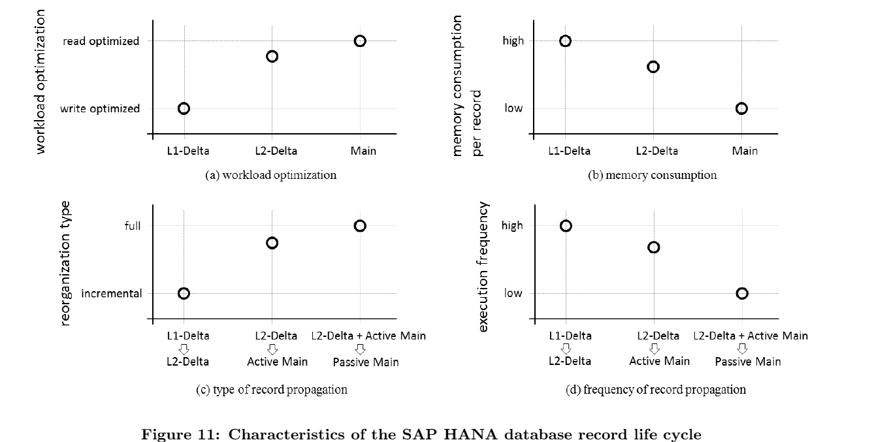
SAP Hana

Slide 19

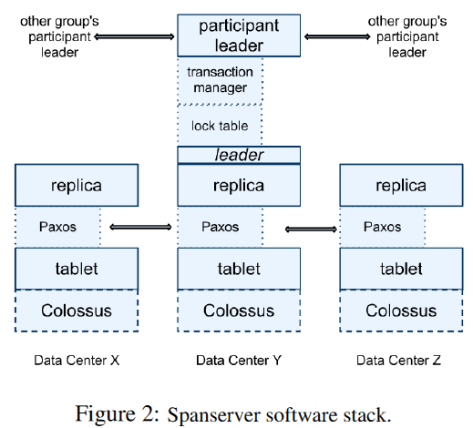
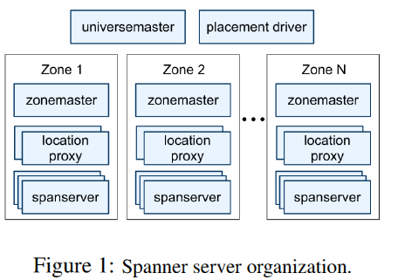
Google Spanner
Globally distributed semi-relational system, SQL-based query lang
Transactional, relies on TrueTime and Paxos

Slide 20
Google F1
Developed for use with AdWords platform replacing MySQL
Relies on Google Spanner
Distributed SQL queries for OLAP-style queries, using snapshot transactions
and two phase commit
Optimistic concurreny control
Transaction consistent secondary indexes
Protocol Buffer as column data type
Clustered hierarchical tables
Increased read, write and commit latencies
5 copy replication
Row or sub-row level locking
Many issues found with inefficiencies of MySQL ORM layer – replaced with F1 ORM
Multiple client consumers of a single query’s results

Slide 21
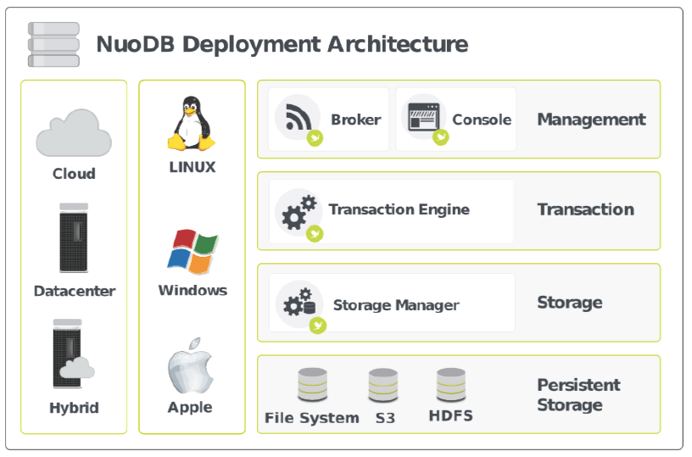
NuoDB
Separates transaction management from storage management – Transaction Engines and Storage Managers
TEs manage data via partial, on-demand replication
Data resides where it is needed and used
NuoDB Cloud on Amazon AWS
Uses multi-version concurrency control (MVCC)

Slide 22
VoltDB (H-Store product)
H-Store origin
In-memory, shared nothing RDBMS
Database is sharded with serial execution of transactions within a shard – user specifies partitioning column for a table
Synchronous replication with reexecution of transactions at replicas
Read only remote backup for disaster recovery
Transaction-level logging rather than ARIES-style page-oriented logging
Periodically consistent snapshots written to disk and transaction-level log used to do recovery
Multi-shard transactions are expensive

Slide 23
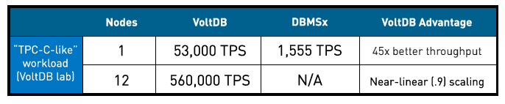
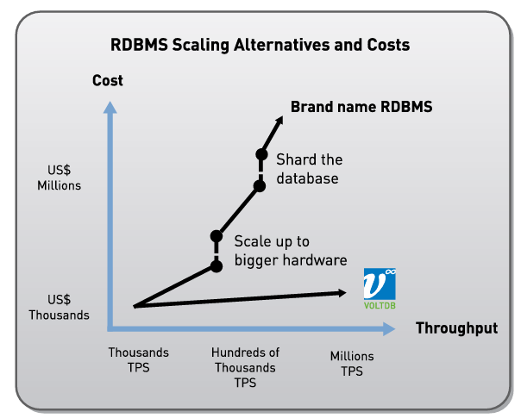
VoltDB (H-Store product)
The Hype on it!

Slide 24
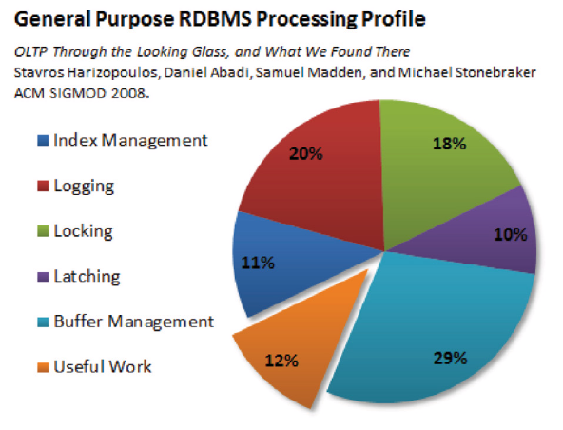
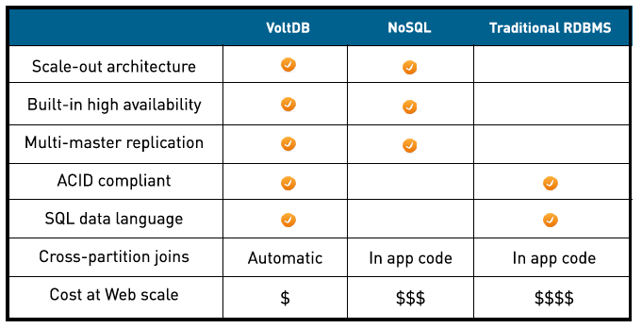
VoltDB

Slide 25
NoSQL Systems

Slide 26
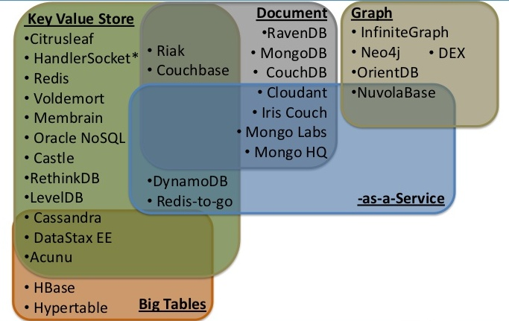
NoSQL Ecosystem - Matthew Aslett 2012

Slide 27
Motivations for NoSQL Systems
Need for flexible data model, schema evolution, …
Many apps (e.g., Web2.0) need fewer features, high scale (data sizes, # of servers), very low response times
Native support for interchange/storage formats like JSON
Sharding RDBMS DBs rigid or unfriendly
High-scale RDBMS too expensive for simple apps
Need for low-latency, low-overhead API to access data
Need to scale-out on cheap commodity nodes with locally-attached SATA disks, especially in cloud context
Increasing use of distributed analytics
Desire for one programming language for imperative programming and persistent data accesses (ref: POS)
For some, access to source code for tailoring for their needs
Flexibility with respect to data consistency

Slide 28
NoSQL Systems
Focus on | Give up
Commodity servers, networking, disks Easy elasticity and scalability to multiple racks (10s to 100s of servers) Fault-tolerance and high availability | Relational data model Standardized SQL APIs Complex queries (joins, secondary indexes) Stronger notion of transactions
Two Worlds
Transactional
Custom high-end OLTP for financial applications
Scaleout datastores for Cloud/Web 2.0
Examples
  MemcacheDB, Cassandra, Dynamo, Voldemort, SimpleDB, Gigaspaces, Websphere eXtreme Scale (WXS)
Analytics
Managing updates
Support for random access and indexing
Scaleout content store
Examples
  Bigtable, HBase, Hypertable

Slide 29
NoSQL Stores
Major open source projects
  Cassandra and HBase
  Other Projects: Voldemort, MongoDB, Hypertable
Mushrooming of startups with tremendous interest from VCs (e.g., Aerospike)
“Scale-out structured storage”: between raw files and DBMS
Commercial flex-schema offerings based on relational technologies: DB2/Informix JSON, MonetDB

Slide 30
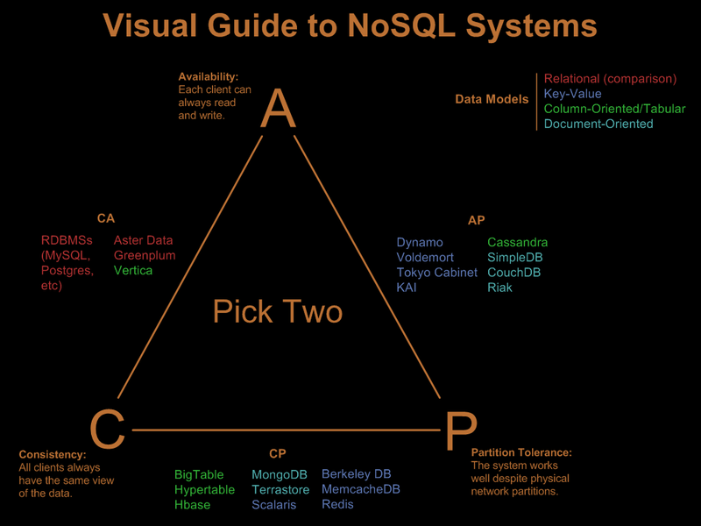
One View of NoSQL Systems – Nathan Hurst, 3/2010?
http://blog.nahurst.com/visual-guide-to-nosql-systems

Slide 31
Concerns/Misgivings (NonsenSQL …)
Throwing baby with bath water analogy comes to mind … many very good developments of last 3 decades discarded … but lot of them coming back … albeit in ad hoc ways on a flaky base
Many past systems that started simple ran into many scalability and other issues – S/38, AS/400, Lotus Notes/Domino, OODBMSs and RDBMSs with page as smallest unit of locking (e.g., mainframe DB2, Sybase/SQLServer, ObjectStore), Single level stores, …
Seat of the pant design in newer systems by highly inexperienced people who haven’t done their homework AND who aren’t documenting enough their designs for others to recognize their deficiencies
Too many misleading claims on novelty of some design features
Ridiculous choices like database level lock in MongoDB
Object granularity as unit of replication locally and for disaster recovery remotely
Myths about ACID transactions and relaxed notions of consistency

Slide 32

MongoDB
Open source document database system (similar to Lotus Notes)
1st release in 2009, Company behind it: MongoDB, Inc
Native support for JSON-like docs with dynamic schemas (BSON)
Indexing, including secondaries
Master slave replication and high availability
Auto sharding
Simple query support
MapReduce functionality could be invoked for complex aggregation
Relies on file system for buffering
GridFS for very large files storage
Common use cases: operational and analytical big data, content management/delivery, mobile/social infrastructure, user data management and data hub.
$231M funding, 300 employees, $1.2B evaluation!

Slide 33
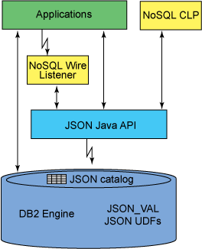
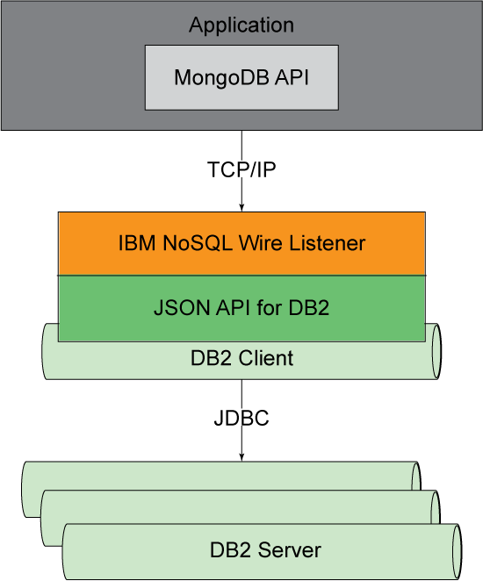
DB2 NoSQL JSON
In addition to support of basic features of the MongoDB query language, DB2 JSON also provides DB2 database server-specific extensions. These extensions enable applying more DB2 database features to JSON documents, for example:
Transaction control to group multiple operations into one commit scope.
Bi-temporal data to associate business time and system time concepts with your JSON data.

Slide 34
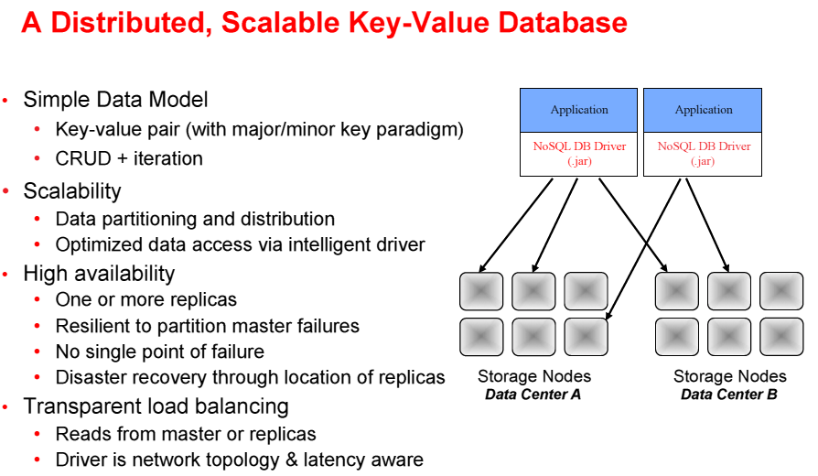
Oracle NoSQL
Lamb, C. Oracle NoSQL Database, Presentation at International Workshop on High Performance Transaction Systems (HPTS), Asilomar, October 2011, http://hpts.ws/papers/2011/sessions_2011/cwl-hpts-for-website.pdf

Slide 35
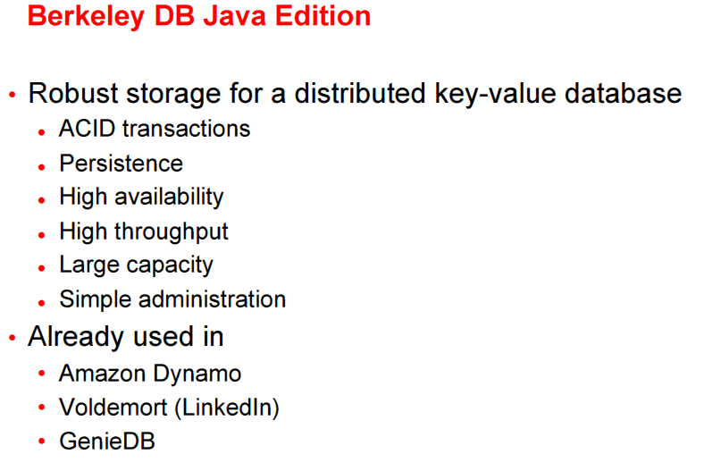

Oracle NoSQL Building Block

Slide 36
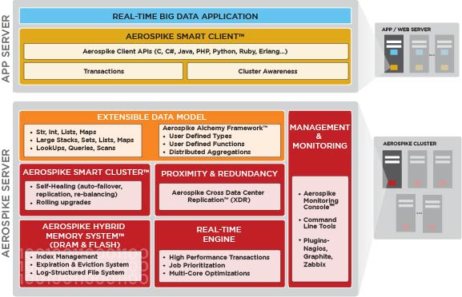
Aerospike
Advocates a hybrid DRAM & Flash system with indexes stored in DRAM & data in flash, disks for persistence
Direct access to flash with own LFS, optimized via small block reads and large block writes
Shared nothing with data distribution using randomized hashing and identical nodes
Uses Paxos for cluster configuration, not for commit logic: all nodes have to agree, not just a majority
Implemented in C for speed with an extensible data model
Master/Slave and Master/Master replication supported
Acquired alchemyDB (used Redis before) being ported onto Aerospike

Slide 37
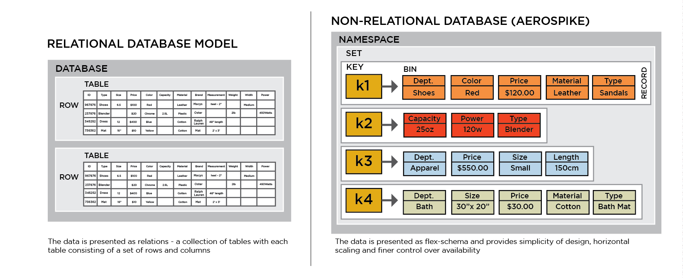
Aerospike
500K TPS on $2K server
1M TPS on $5K server
$1 for 250 TPS
Scaling by mitigating network-I/O-soft-interrupt overhead & avoiding unnecessary context switches – isolate NIC-Physical CPU, NUMA sensitive memory allocation, dedicated core for NIC hardware interrupt handling on > 4 core CPUs

Slide 38
Facebook Case Study
mySQL + memcache for real time access to PBs of data
TAO for consistency across big geographies
Haystack for managing photos (3B new ones per week)
Apache Hadoop for mining intelligence from 100PBs of click logs
Apache HBase for FB messages
Data warehouse in Hive
Scuba for real time event data handling – in-memory

Slide 39
Hybrid Systems: Hadoop + SQL

Slide 40


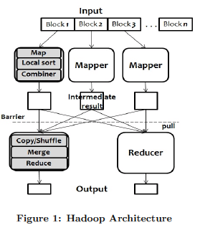

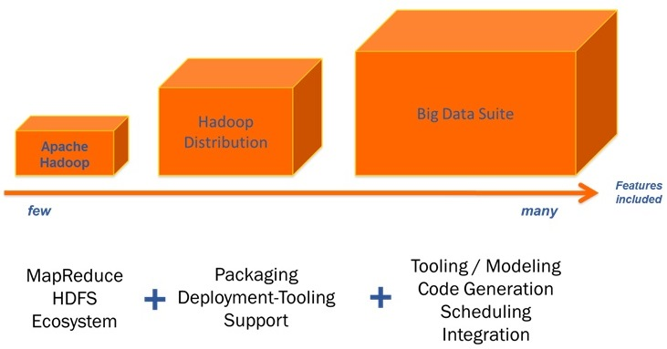
Hadoop

Slide 41
Hadoop
Apache Hadoop Modules: Common, Hadoop Distributed File System (HDFS), MapReduce, YARN
Hadoop Ecosystem: Flume, HBase, Hive, Pig, Sqoop, Zookeeper
Hadoop Distributions: Amazon Elastic MapReduce, Cloudera CDH, HortonWorks, IBM BigInsights, MapR, Pivotal HD
Cloudera Impala: Distributed query execution engine for Apache HDFS/HBase data
Apache Hadoop 2 (Rel 2.2.0) GAed on 15 October 2013
Largest known production Hadoop environment: >35K nodes at Yahoo
New: HA and Snapshots for HDFS data, YARN (aka MRv2 – ResourceManager, ApplicationMaster, NodeManager), Federation support (Multiple Independent Namenodes & Namespaces)

Slide 42
Summary
Good that many shortcomings of RDBMSs began to be addressed by user community (Web 2.0 companies)
More rigor needed in rationalizing design choices
Just because data model isn’t relational doesn’t mean internals have to be different or lessons from the past don’t apply
Let us not rediscover problems and adopt solutions with significant shortcomings
Longer time issues not considered in addressing more immediate needs (migration, skills, tools, optimization, …)
Let us not allow history to repeat itself
Shakeout and market consolidation will happen

